Slide 1
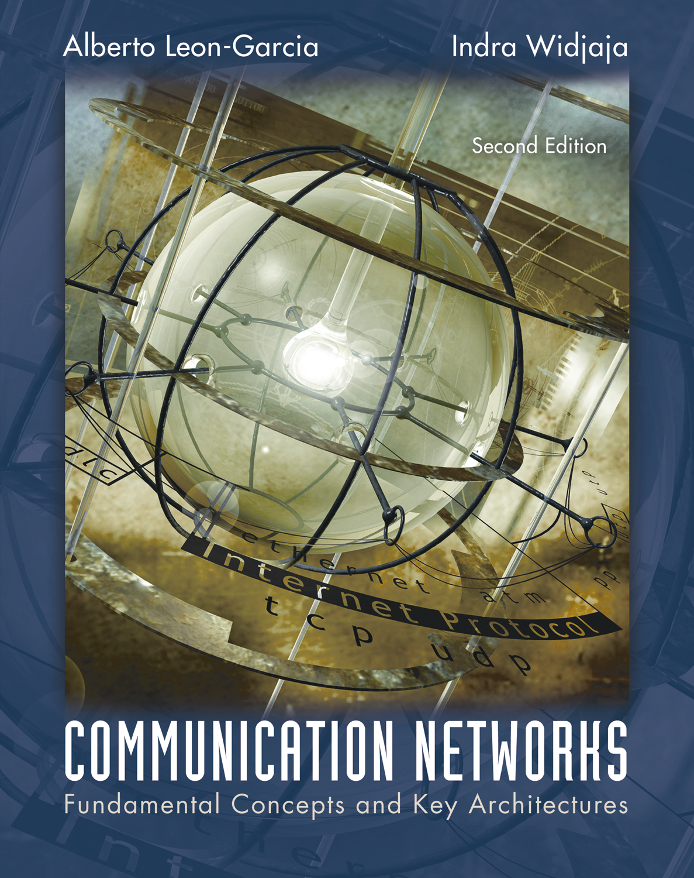
Medium Access Control Protocols
Dhruba Jyoti Kalita

Slide 2
Medium Access Control Protocols
1 Multiple Access Communications
2 Random Access
Scheduling
Channelization
Delay Performance

Slide 3
Multiple Access Communications
Shared media basis for broadcast networks
  Inexpensive: radio over air; copper or coaxial cable
  M users communicate by broadcasting into medium
Key issue: How to share the medium?
3
2
4
1
Shared multiple
access medium
M
5
…

Slide 4
Approaches to Media Sharing
Medium sharing techniques
Static channelization
Dynamic medium access control
Partition medium
Dedicated allocation to users
Satellite transmission
Cellular Telephone
Scheduling
Random access
Polling: take turns
Request for slot in transmission schedule
Token ring
Wireless LANs
Loose coordination
Send, wait, retry if necessary
Aloha
Ethernet

Slide 5
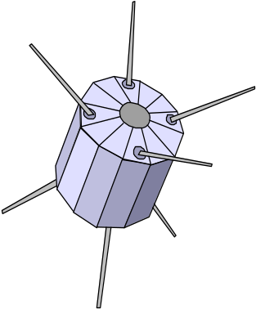

Channelization: Satellite
Satellite Channel
uplink f_{in}
downlink f_{out}

Slide 6


Channelization: Cellular
uplink f₁ ; downlink f₂
uplink f₃ ; downlink f₄

Slide 7
Scheduling: Polling
Inbound line
Data from 1
Data from 2
Poll 1
Poll 2
Data to M
Outbound line
Host
computer
1
2
3
M
Stations

Slide 8
Scheduling: Token-Passing
Ring networks
token
Data to M
token
Station that holds token transmits into ring

Slide 9
Random Access
Multi-tapped Bus
Crash!!
Transmit when ready
Transmissions can occur; need retransmission strategy

Slide 10


Wireless LAN
AdHoc: station-to-station
Infrastructure: stations to base station
Random access & polling

Slide 11
Selecting a Medium Access Control
Applications
  What type of traffic?
  Voice streams? Steady traffic, low delay/jitter
  Data? Short messages? Web page downloads?
  Enterprise or Consumer market? Reliability, cost
Scale
  How much traffic can be carried?
  How many users can be supported?
Current Examples:
  Design MAC to provide wireless-DSL-equivalent access to rural communities
  Design MAC to provide wireless-LAN-equivalent access to mobile users (user in car travelling at 100 km/hr)

Slide 12
Delay-Bandwidth Product
Delay-bandwidth product is key parameter
  Coordination in sharing medium involves using bandwidth (explicitly or implicitly)
  How many bits are enroute from source to destination?→Prop delay * bandwidth
Simple two-station example
  Station with frame to send listens to medium and transmits if medium found idle
  Station monitors medium to detect collision
  If collision occurs, station that begin transmitting earlier retransmits

Slide 13
Two-Station MAC Example
Two stations are trying to share a common medium
Distance d meters
t_{prop} = d / ν seconds
A transmits at t = 0
A
B
Case 1
B does not transmit before t = t_{prop} & A captures channel
A
B
Case 2
B transmits before t = t_{prop} and detects
collision soon
thereafter
A
B
A detects
collision at
t = 2 t_{prop}
A
B

Slide 14
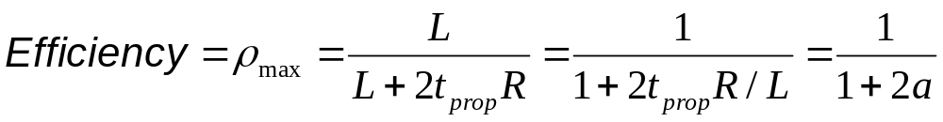
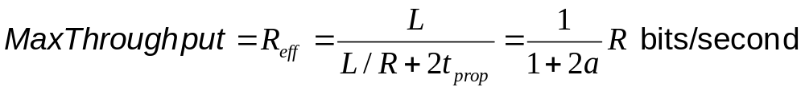
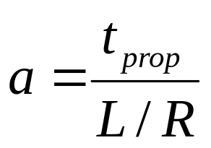
Efficiency of Two-Station Example
Each frame transmission requires 2t_{prop} of quiet time
  Station B needs to be quiet t_{prop} before and after time when Station A transmits
  R transmission bit rate
  L bits/frame
Normalized Delay-Bandwidth Product
Propagation delay
Time to transmit a frame

Slide 15
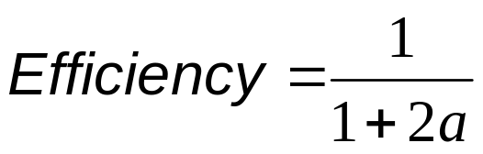
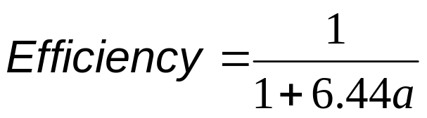
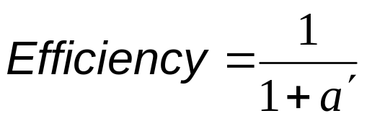
Typical MAC Efficiencies
Two-Station Example:
If a<<1, then efficiency close to 100%
As a approaches 1, the efficiency becomes low
CSMA-CD (Ethernet) protocol:
Token-ring network
a΄= latency of the ring (bits)/average frame length

Slide 16
Typical Delay-Bandwidth Products
Distance | 10 Mbps | 100 Mbps | 1 Gbps | Network Type
1 m | 3.33 x 10⁻⁰² | 3.33 x 10⁻⁰¹ | 3.33 x 10⁰ | Desk area network
100 m | 3.33 x 10⁰¹ | 3.33 x 10⁰² | 3.33 x 10⁰³ | Local area network
10 km | 3.33 x 10⁰² | 3.33 x 10⁰³ | 3.33 x 10⁰⁴ | Metropolitan area network
1000 km | 3.33 x 10⁰⁴ | 3.33 x 10⁰⁵ | 3.33 x 10⁰⁶ | Wide area network
100000 km | 3.33 x 10⁰⁶ | 3.33 x 10⁰⁷ | 3.33 x 10⁰⁸ | Global area network
Max size Ethernet frame: 1500 bytes = 12000 bits
Long and/or fat pipes give large a

Slide 17
MAC protocol features
Delay-bandwidth product
Efficiency
Transfer delay
Fairness
Reliability
Capability to carry different types of traffic
Quality of service
Cost

Slide 18
MAC Delay Performance
Frame transfer delay
  From first bit of frame arrives at source MAC
  To last bit of frame delivered at destination MAC
Throughput
  Actual transfer rate through the shared medium
  Measured in frames/sec or bits/sec
Parameters
  R bits/sec & L bits/frame
  X=L/R seconds/frame
  λ frames/second average arrival rate
  Load ρ = λ X, rate at which “work” arrives
  Maximum throughput (@100% efficiency): R/L fr/sec

Slide 19
Normalized Delay versus Load
E[T]/X
E[T] = average frame
transfer delay
At low arrival rate, only frame transmission time
At high arrival rates, increasingly longer waits to access channel
Max efficiency typically less than 100%
X = average frame
transmission time
Transfer delay
1
ρ
ρ_{max}
1
Load

Slide 20
Dependence on Rt_{prop}/L
E[T]/X
a′ > a
a′
a
Transfer Delay
1
ρ
ρ′_{max}
ρ_{max}
1
Load

Slide 21
Medium Access Control Protocols
2 Random Access

Slide 22
ALOHA
Wireless link to provide data transfer between main campus & remote campuses of University of Hawaii
Simplest solution: just do it
  A station transmits whenever it has data to transmit
  If more than one frames are transmitted, they interfere with each other (collide) and are lost
  If ACK not received within timeout, then a station picks random backoff time (to avoid repeated collision)
  Station retransmits frame after backoff time
First transmission
Retransmission
Backoff period B
t
t₀-X
t₀
t₀+X
t₀+X+2t_{prop}
t₀+X+2t_{prop} + B
Vulnerable
period
Time-out

Slide 23
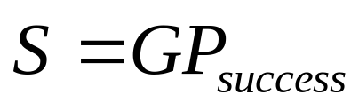
ALOHA Model
Definitions and assumptions
  X: frame transmission time (assume constant)
  S: throughput (average # of successful frame transmissions per X seconds)
  G: load (average # of transmission attempts per X sec.)
  P_{success} : probability a frame transmission is successful
Any transmission that begins during vulnerable period leads to collision
Success if no arrivals during 2X seconds
X
X
Prior interval
frame transmission

Slide 24
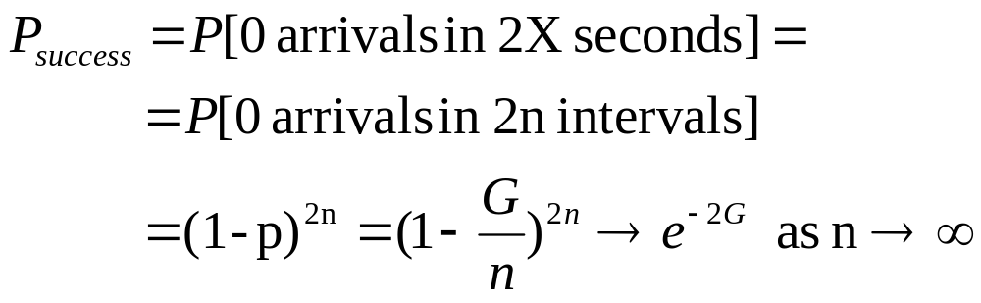
Abramson’s Assumption
What is probability of no arrivals in vulnerable period?
Abramson assumption: Effect of backoff algorithm is that frame arrivals are equally likely to occur at any time interval
G is avg. # arrivals per X seconds
Divide X into n intervals of duration Δ=X/n
p = probability of arrival in Δ interval, then
G = n p since there are n intervals in X seconds

Slide 25
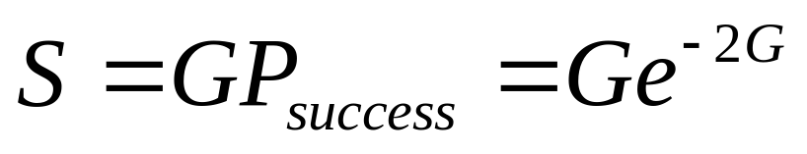
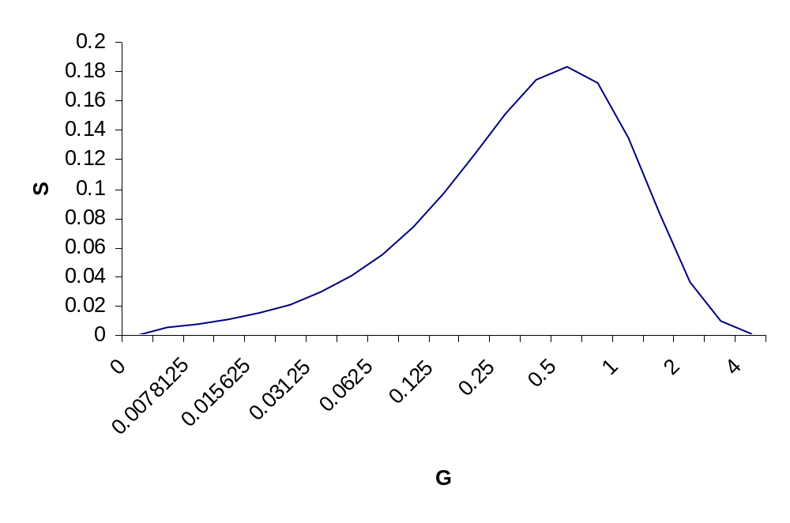
Throughput of ALOHA
Collisions are means for coordinating access
Max throughput is ρ_{max}= 1/2e (18.4%)
Bimodal behavior:
  Small G, S≈G
  Large G, S↓0
Collisions can snowball and drop throughput to zero
e⁻² = 0.184

Slide 26
Slotted ALOHA
Time is slotted in X seconds slots
Stations synchronized to frame times
Stations transmit frames in first slot after frame arrival
Backoff intervals in multiples of slots
Backoff period B
t
kX
(k+1)X
t₀ +X+2t_{prop}
t₀ +X+2t_{prop}+ B
Vulnerableperiod
Time-out
Only frames that arrive during prior X seconds collide

Slide 27
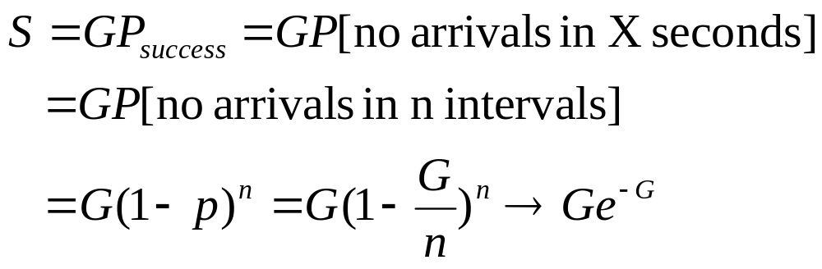
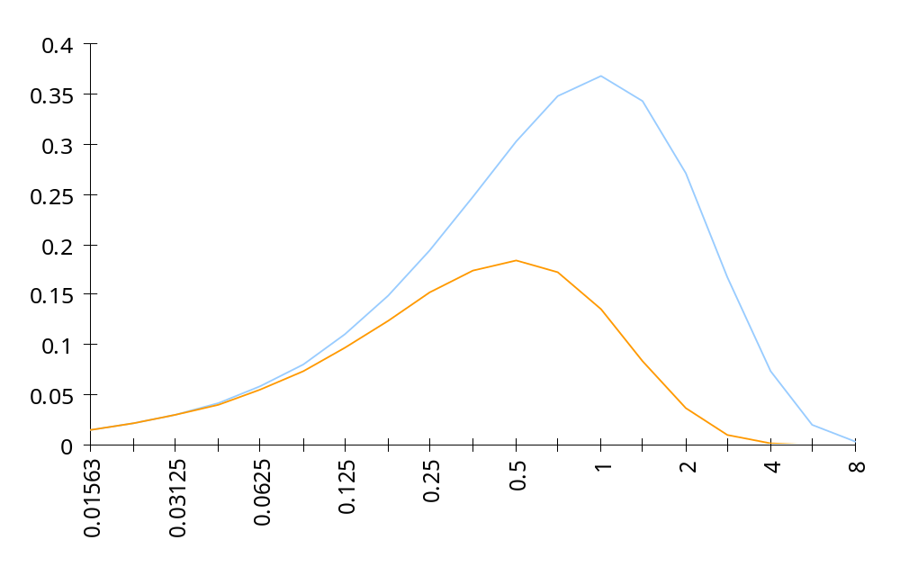
Throughput of Slotted ALOHA
0.368
Max throughput is ρ_{max}= e (36.8%)
S
Ge^{-G}
0.184
Ge^{-2G}
G

Slide 28
Application of Slotted Aloha
cycle
. . .
. . .
Reservation mini-slots
X-second slot
Reservation protocol allows a large number of stations with infrequent traffic to reserve slots to transmit their frames in future cycles
Each cycle has mini-slots allocated for making reservations
Stations use slotted Aloha during mini-slots to request slots

Slide 29
Carrier Sensing Multiple Access (CSMA)
A station senses the channel before it starts transmission
  If busy, either wait or schedule backoff (different options)
  If idle, start transmission
  Vulnerable period is reduced to t_{prop} (due to channel capture effect)
  When collisions occur they involve entire frame transmission times
  If t_{prop} >X (or if a>1), no gain compared to ALOHA or slotted ALOHA
Station A begins transmission at t = 0
A
Station A captures
channel at t = t_{prop}
A

Slide 30
CSMA Options
Transmitter behavior when busy channel is sensed
  1-persistent CSMA (most greedy)
    Start transmission as soon as the channel becomes idle
    Low delay and low efficiency
  Non-persistent CSMA (least greedy)
    Wait a backoff period, then sense carrier again
    High delay and high efficiency
  p-persistent CSMA (adjustable greedy)
    Wait till channel becomes idle, transmit with prob. p; or wait one mini-slot time & re-sense with probability 1-p
    Delay and efficiency can be balanced
Sensing

Slide 31
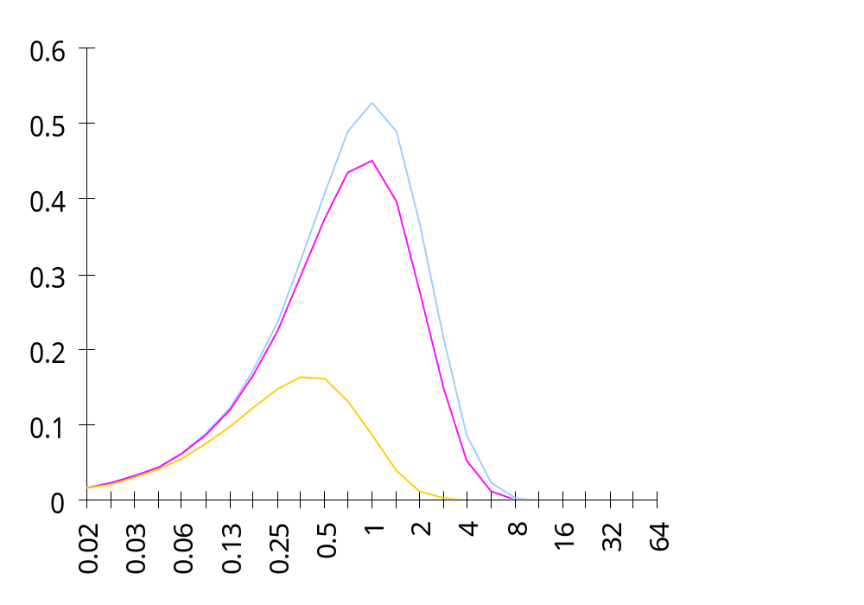
1-Persistent CSMA Throughput
S
0.53
Better than Aloha & slotted Aloha for small a
Worse than Aloha for a > 1
a = 0.01
0.45
0.16
a =0.1
G
a = 1

Slide 32
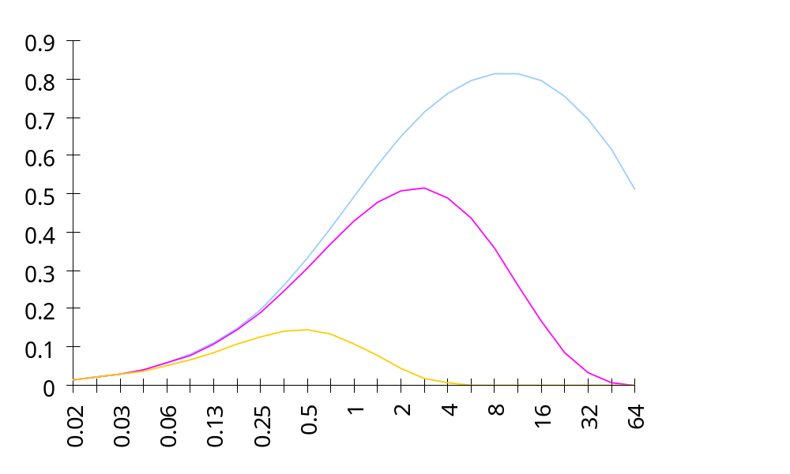
Non-Persistent CSMA Throughput
a = 0.01
S
0.81
Higher maximum throughput than 1-persistent for small a
Worse than Aloha for a > 1
0.51
a = 0.1
0.14
G
a = 1

Slide 33
CSMA with Collision Detection (CSMA/CD)
Monitor for collisions & abort transmission
  Stations with frames to send, first do carrier sensing
  After beginning transmissions, stations continue listening to the medium to detect collisions
  If collisions detected, all stations involved stop transmission, reschedule random backoff times, and try again at scheduled times
In CSMA, collisions result in wastage of X seconds spent transmitting an entire frame
CSMA-CD reduces wastage to time to detect collision and abort transmission

Slide 34
CSMA/CD reaction time
A begins to
transmit at
t = 0
A
B
B begins to
transmit at
t = t_{prop}- δ; 
B detects
collision at
t = t_{prop}
A
B
A detects
collision at
t= 2 t_{prop}- δ
A
B
It takes 2 t_{prop} to find out if channel has been captured

Slide 35
CSMA-CD Model
Assumptions
  Collisions can be detected and resolved in 2t_{prop}
  Time slotted in 2t_{prop} slots during contention periods
  Assume n busy stations, and each may transmit with probability p in each contention time slot
  Once the contention period is over (a station successfully occupies the channel), it takes X seconds for a frame to be transmitted
  It takes t_{prop} before the next contention period starts.
(a)
Busy
Contention
Busy
Idle
Contention
Busy
Time

Slide 36
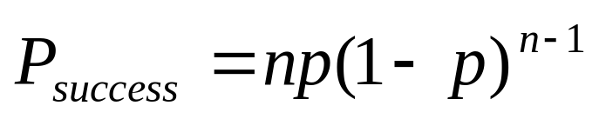
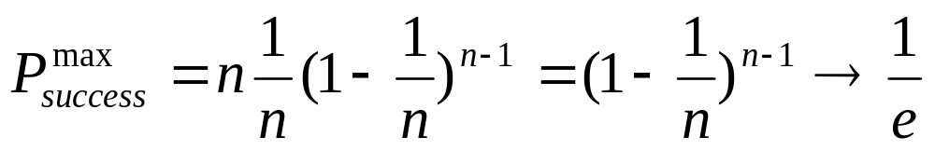
Contention Resolution
How long does it take to resolve contention?
Contention is resolved (“success’) if exactly 1 station transmits in a slot:
By taking derivative of P_{success} we find max occurs at p=1/n
On average, 1/P^{max} = e = 2.718 time slots to resolve contention

Slide 37
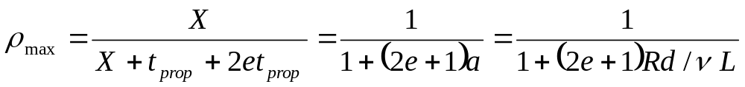
CSMA/CD Throughput
Busy
Contention
Busy
Contention
Busy
Contention
Busy
Time
At maximum throughput, systems alternates between contention periods and frame transmission times
where:
  R bits/sec, L bits/frame, X=L/R seconds/frame
  a = t_{prop}/X
  ν meters/sec. speed of light in medium
  d meters is diameter of system
  2e+1 = 6.44

Slide 38
CSMA-CD Application: Ethernet
First Ethernet LAN standard used CSMA-CD
  1-persistent Carrier Sensing
  R = 10 Mbps
  t_{prop} = 51.2 microseconds
    512 bits = 64 byte slot
    accommodates up to 2.5 km using 4 repeaters
  Uses Binary Exponential Backoff
    After nth collision, select backoff from {0, 1,…, 2^{k} – 1}, where k=min(n, 10)

